Slide 1
Diploma project
Orders In / Out of a Restaurant
By Vladimir Blaskov - 18114037

Slide 2
How to run the project?
Download the files I uploaded
Go to the resources folders, there start by migrating the first data for the database and then the other two.
Go to appsettings.json, in order to change the connection string for MySQL with your credentials
Run it

Slide 3

How is the project created?
The project “Orders In / Out of a Restaurant” is an ASP.NET (which we have studied and made practical assignments during our university lectures) web application, consisting of .NET with C#, HTML, CSS, Javascript, frameworks like Boostrap, etc. It is connected to a MySQL server, with a database of 10 tables, which are connected to each other, along with the journal table, along with the requirements.

Slide 4
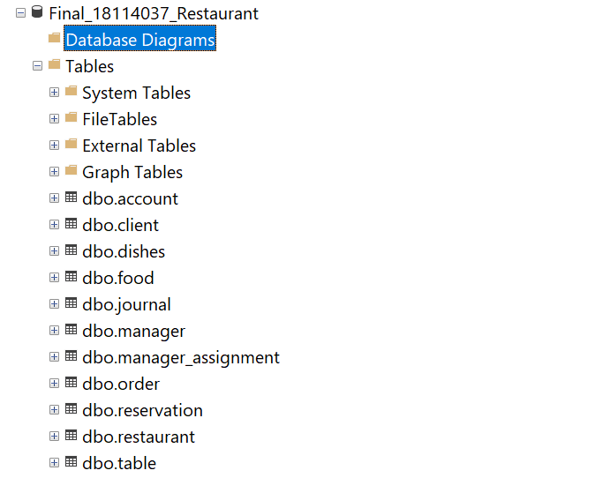
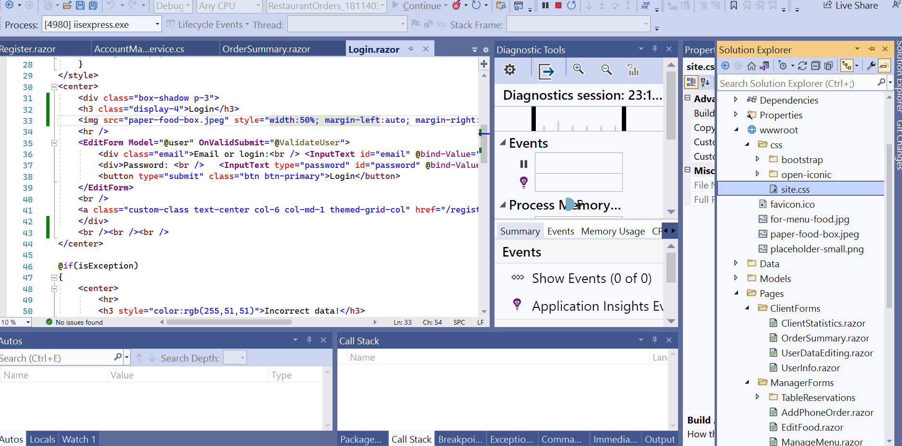

Slide 5
The database

Slide 6
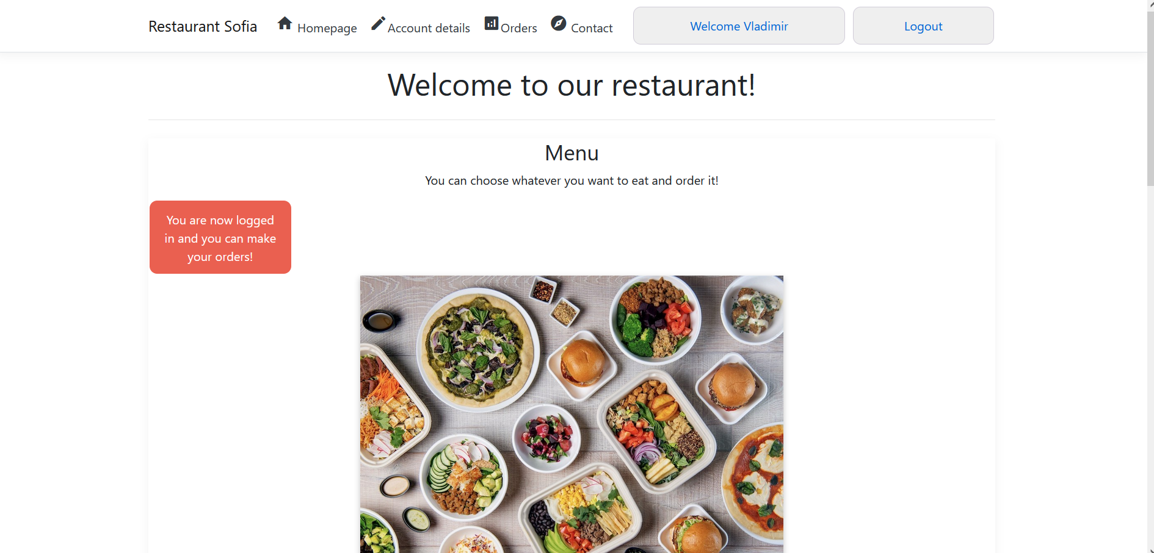
The user interface
I focused on creating a user friendly interface, in order for a user and a manager of a restaurant, to be able to make and receive orders and manage his restaurant

Slide 7
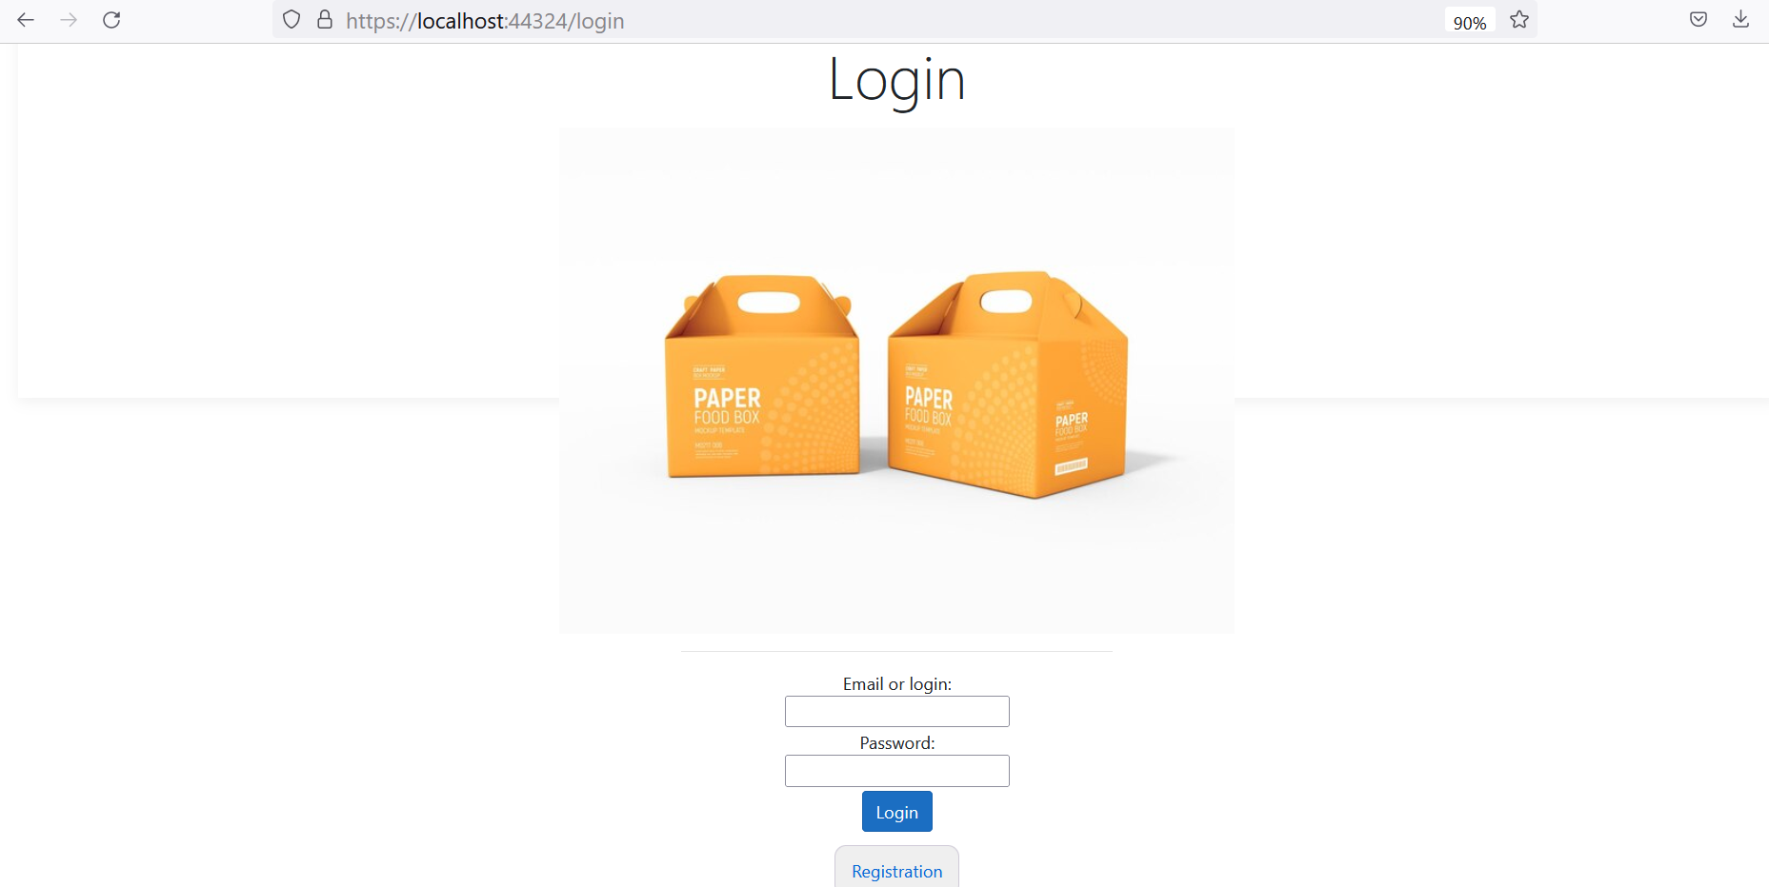
Authentication
The authentication happens by creating an account, after that you can make orders, or depending on your role, you can control the orders, the tables at the restaurant, etc.

Slide 8
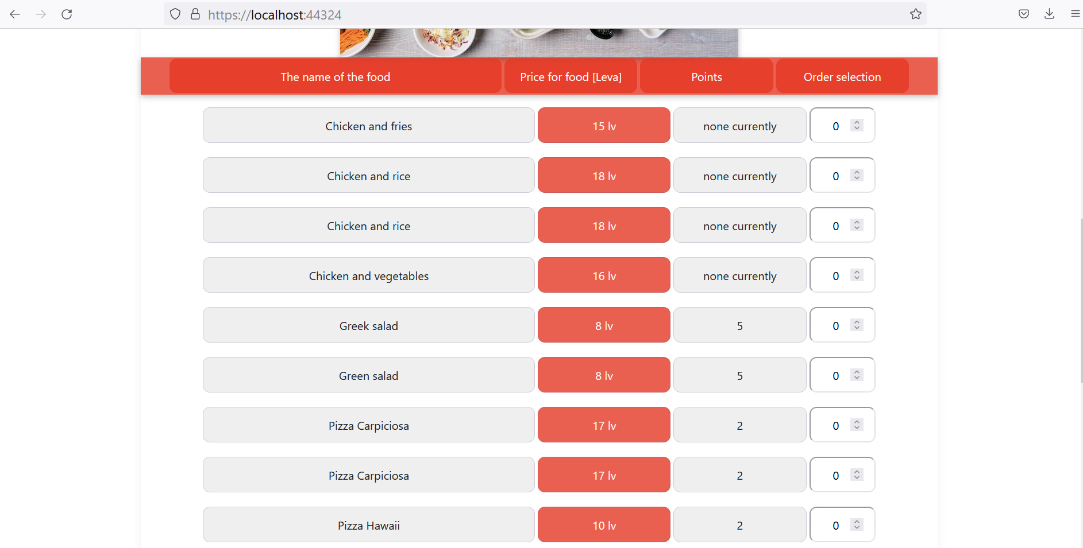
CRUD operations
All the users of any role, can perform all type of Create, Update, Read and Delete operations in the application, depending on what exactly they want to do, whether they want to order or edit their details.

Slide 9
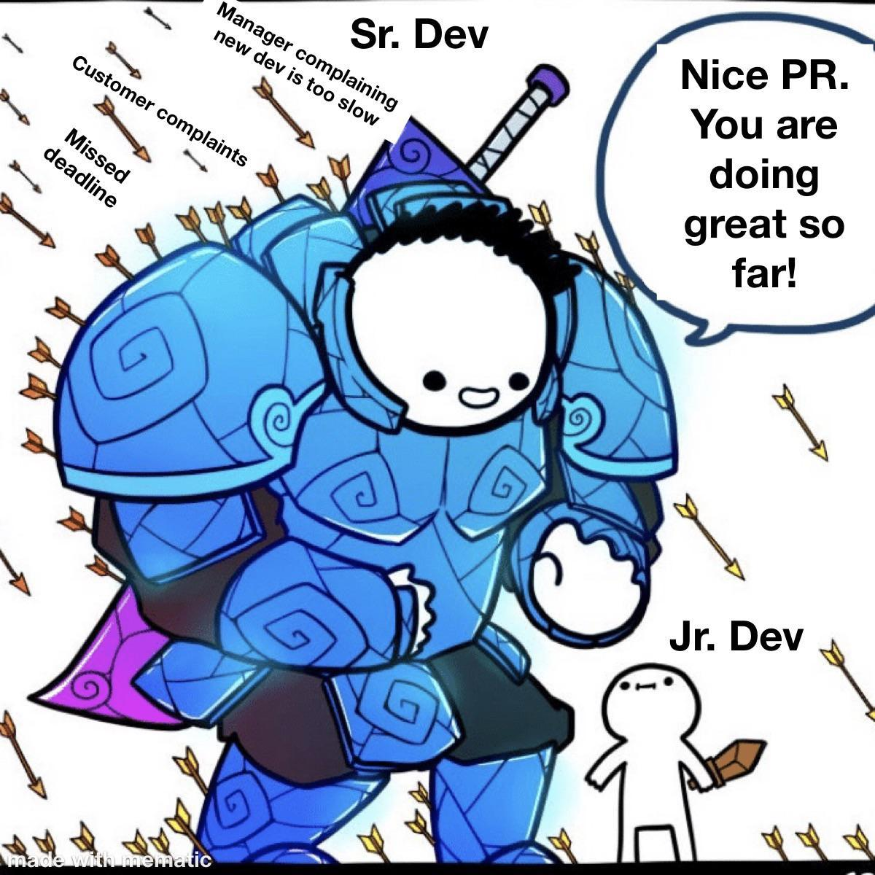
Thank you for your attention

